Slide 1
SMARTCARD Product PROFILE
FEITIAN Technologies Co., Ltd.

Slide 2
ABOUT
FEITIAN

Slide 3
ABOUT FEITIAN
OVERVIEW
1998
FOUNDEN IN
Protect the entire
digital lifecycle
1,000⁺
EMPLOYEE
Diversity & integrity
Over half are R&Ds
3,000⁺
CUSTOMER
Develope partnerships
over 150 countries
1,600⁺
PATENT
Intellectual property
technologies
80M⁺/Year
SHIPMENT
Products shipped
globally per year

Slide 4
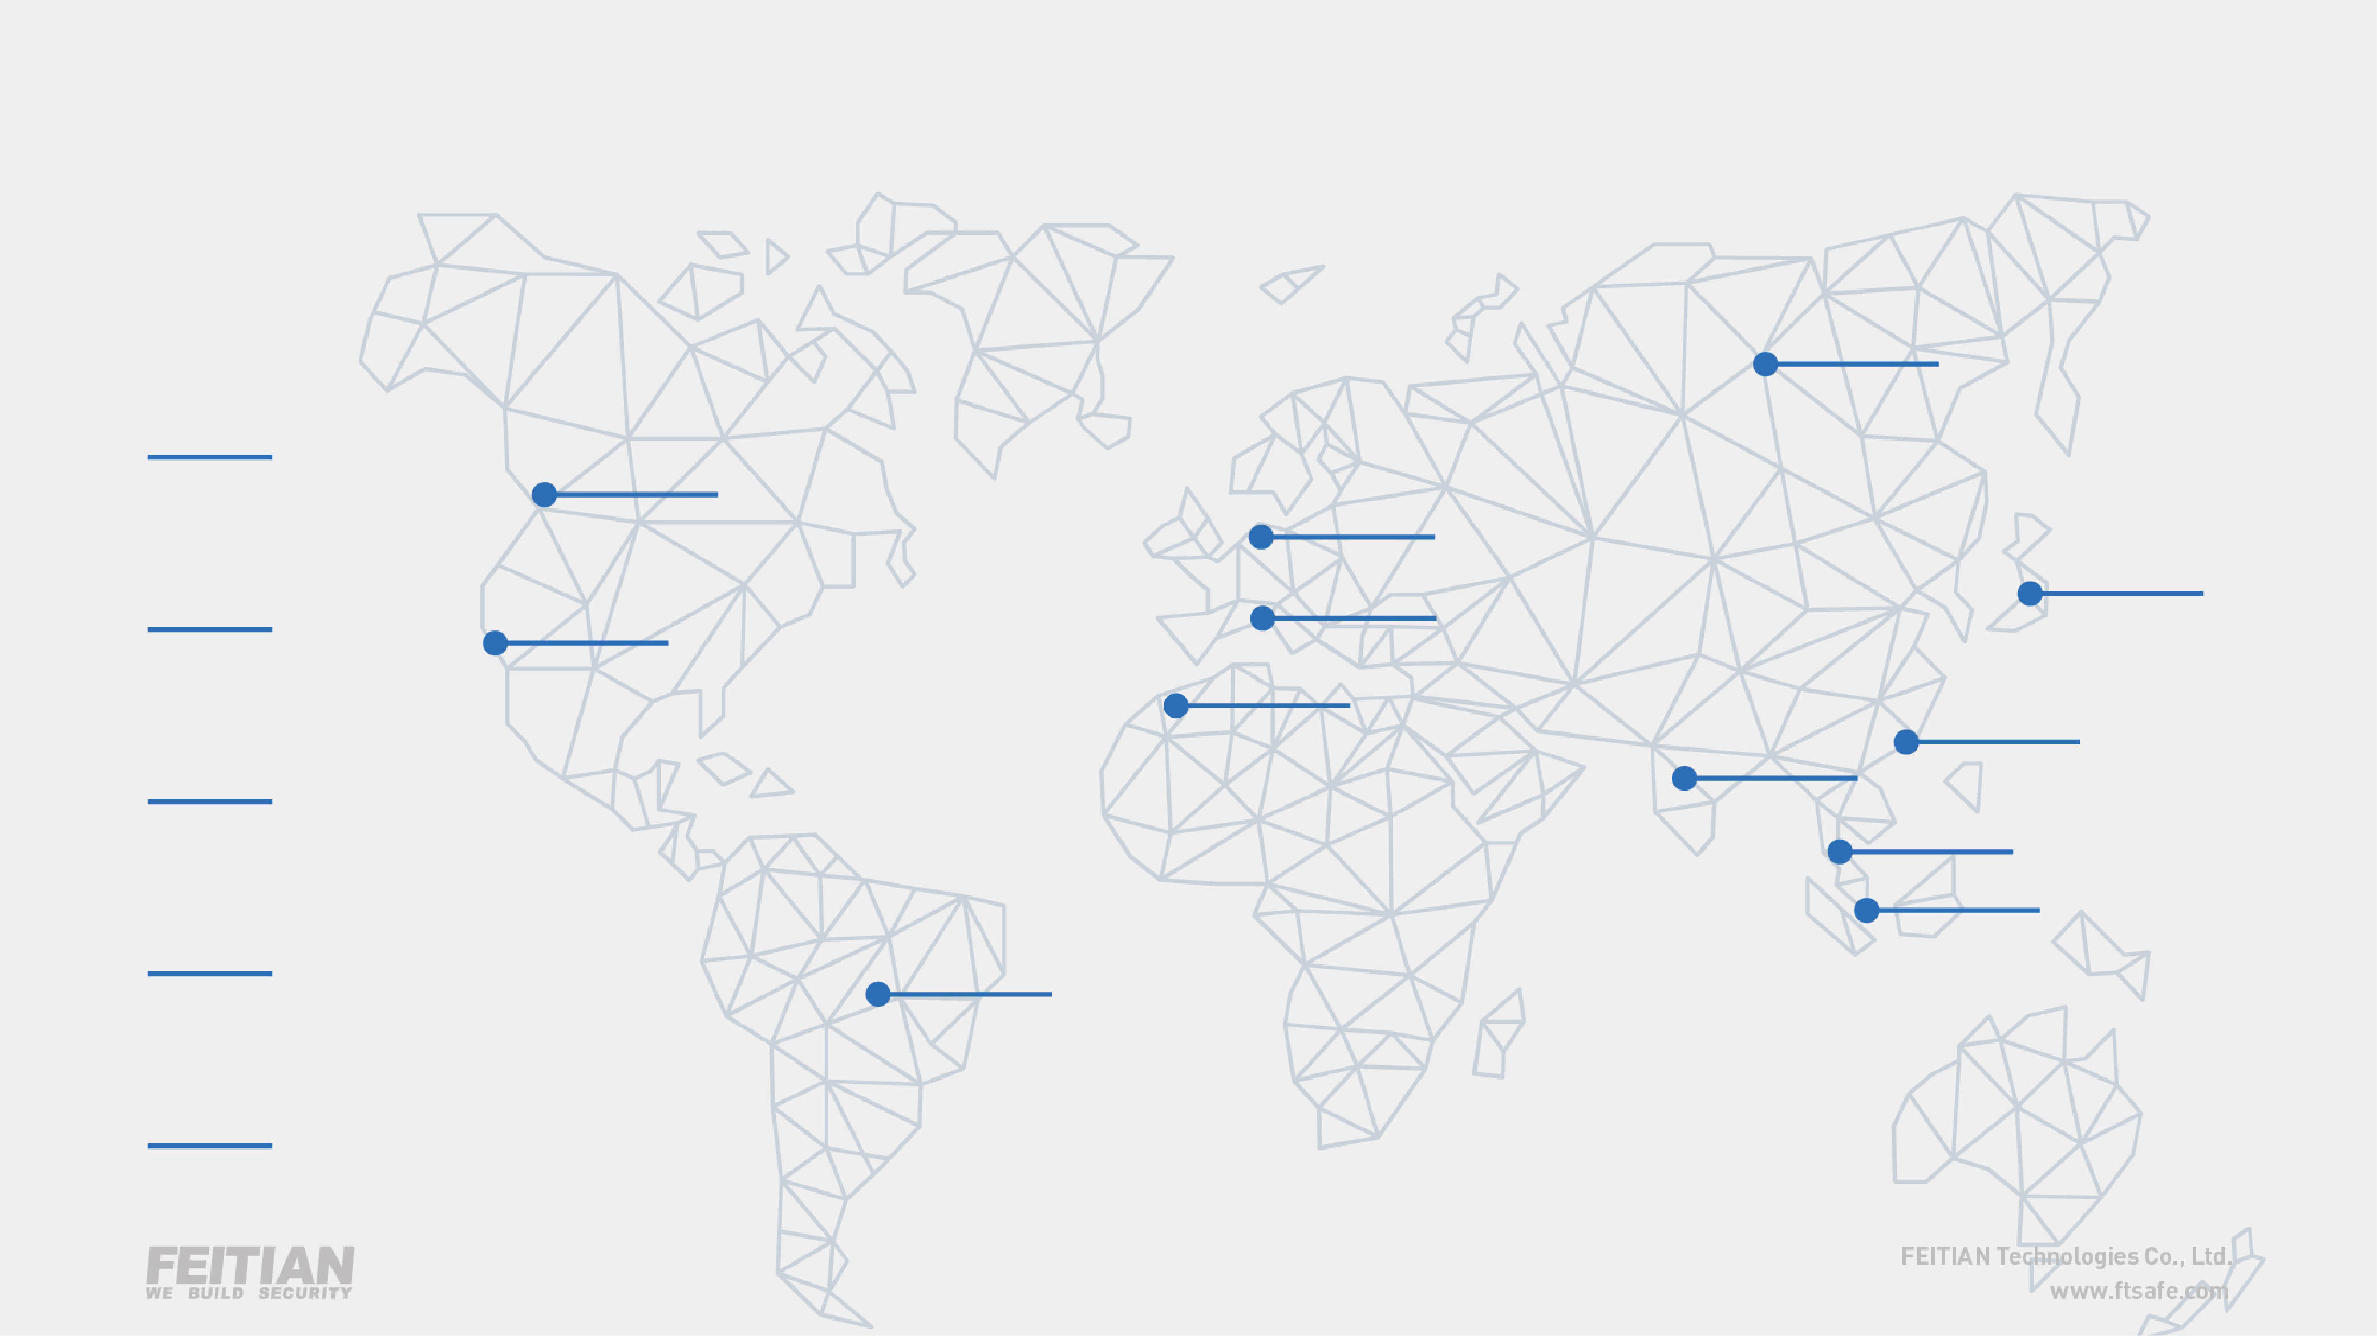
ABOUT FEITIAN
GLOBAL PRESENCE
Russia
2
Subsidiaries
Canada
Netherlands
2
JV Partners
Japan
USA
France
7
Sales Outlets
Morocco
Hong Kong
India
Malaysia
5,000+
Clients
Singapore
Brazil
150+
Countries

Slide 5
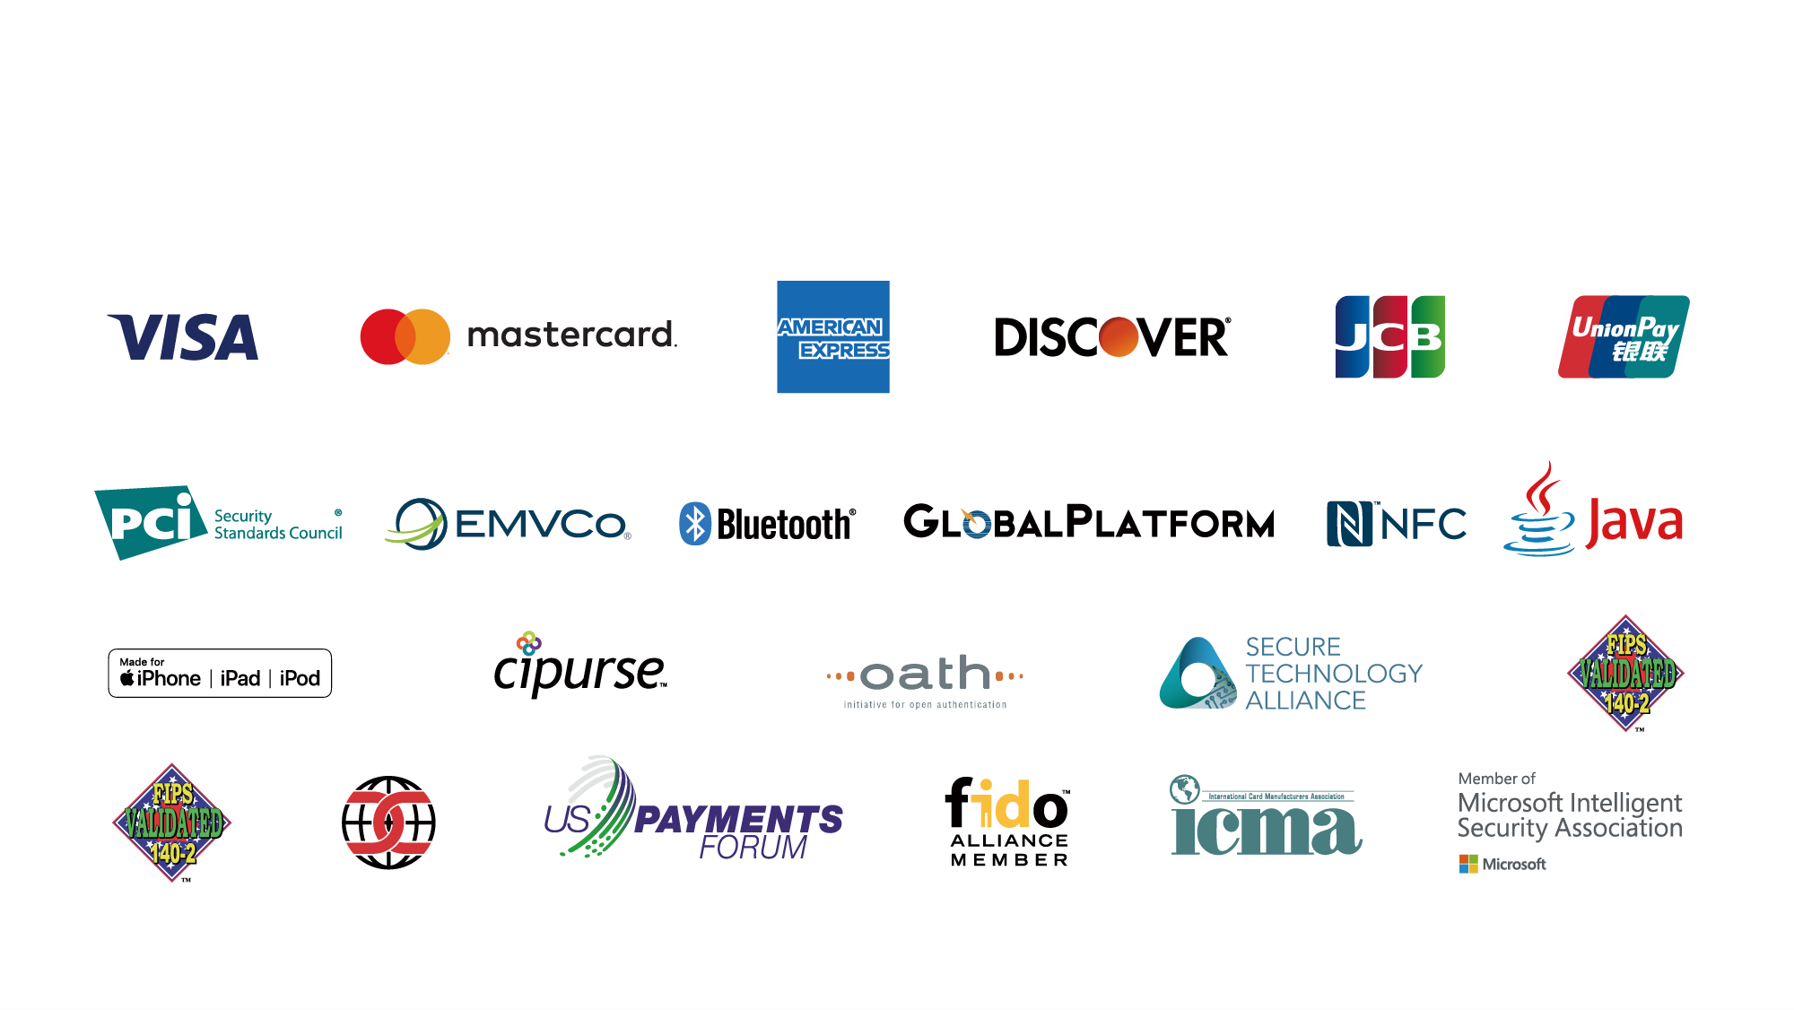
ABOUT FEITIAN
CERTIFICATIONS & MEMBERSHIPS

Slide 6
ABOUT FEITIAN
CUSTOMER REFERENCE

Slide 7
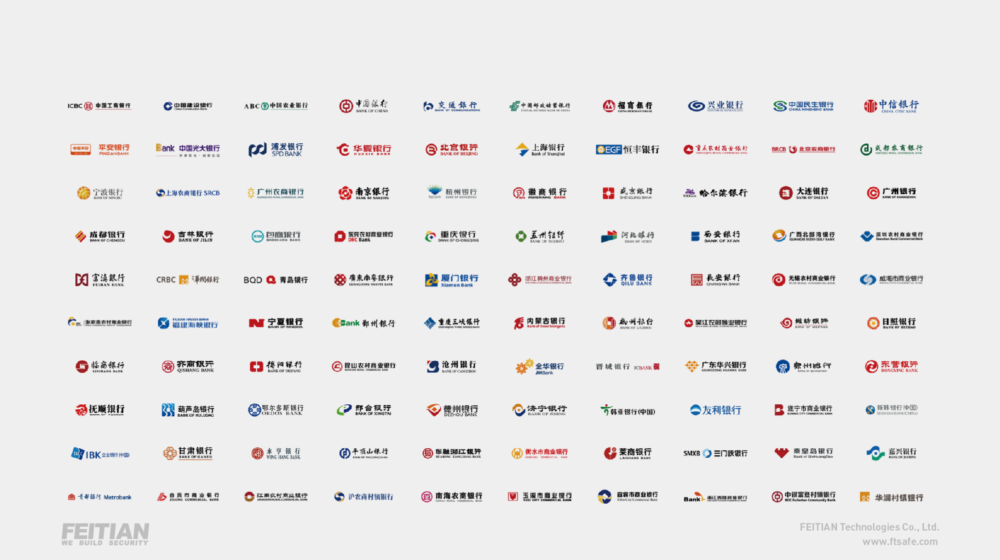
ABOUT FEITIAN
Domestic Banking Customers

Slide 8
SMARTCARD
PRODUCTS

Slide 9
SMARTCARD PRODUCTS
What We provide?
Applets
Qualification& Certification
FT-JCOS
SMARTCARD JAVA OS
Hardware (Module)
Card Body
Personal Script, Personal Software,
Personal Service, Personal Document

Slide 10
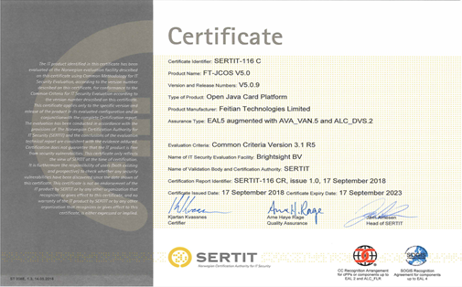
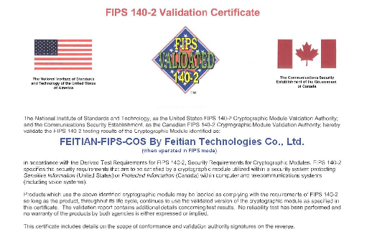
SMARTCARD PRODUCTS
FEITIAN Own Java OS for Smart Card: FT-JCOS
Security
certificate
CC EAL5+
FIPS 140-2

Slide 11
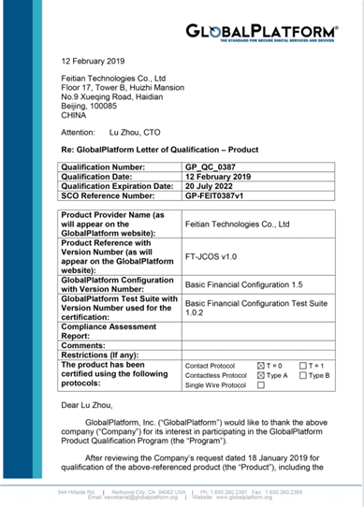
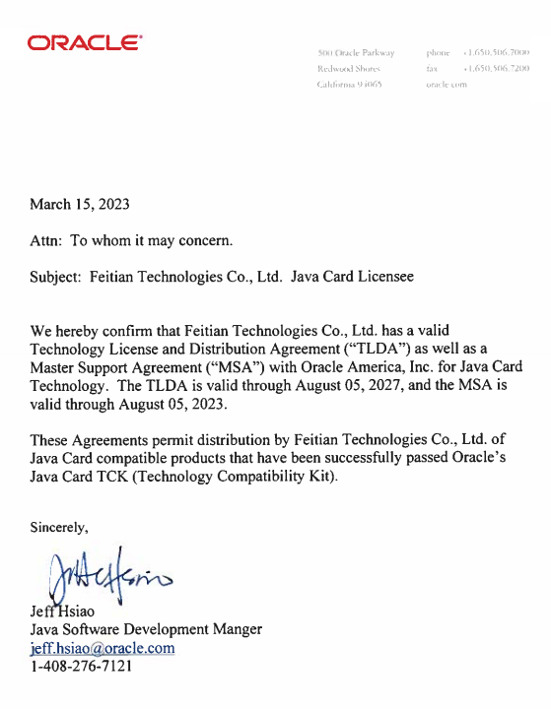
SMARTCARD PRODUCTS
FEITIAN Own Java OS for Smart Card: FT-JCOS
Standard certificate
GP Qualification
Java Licensee

Slide 12
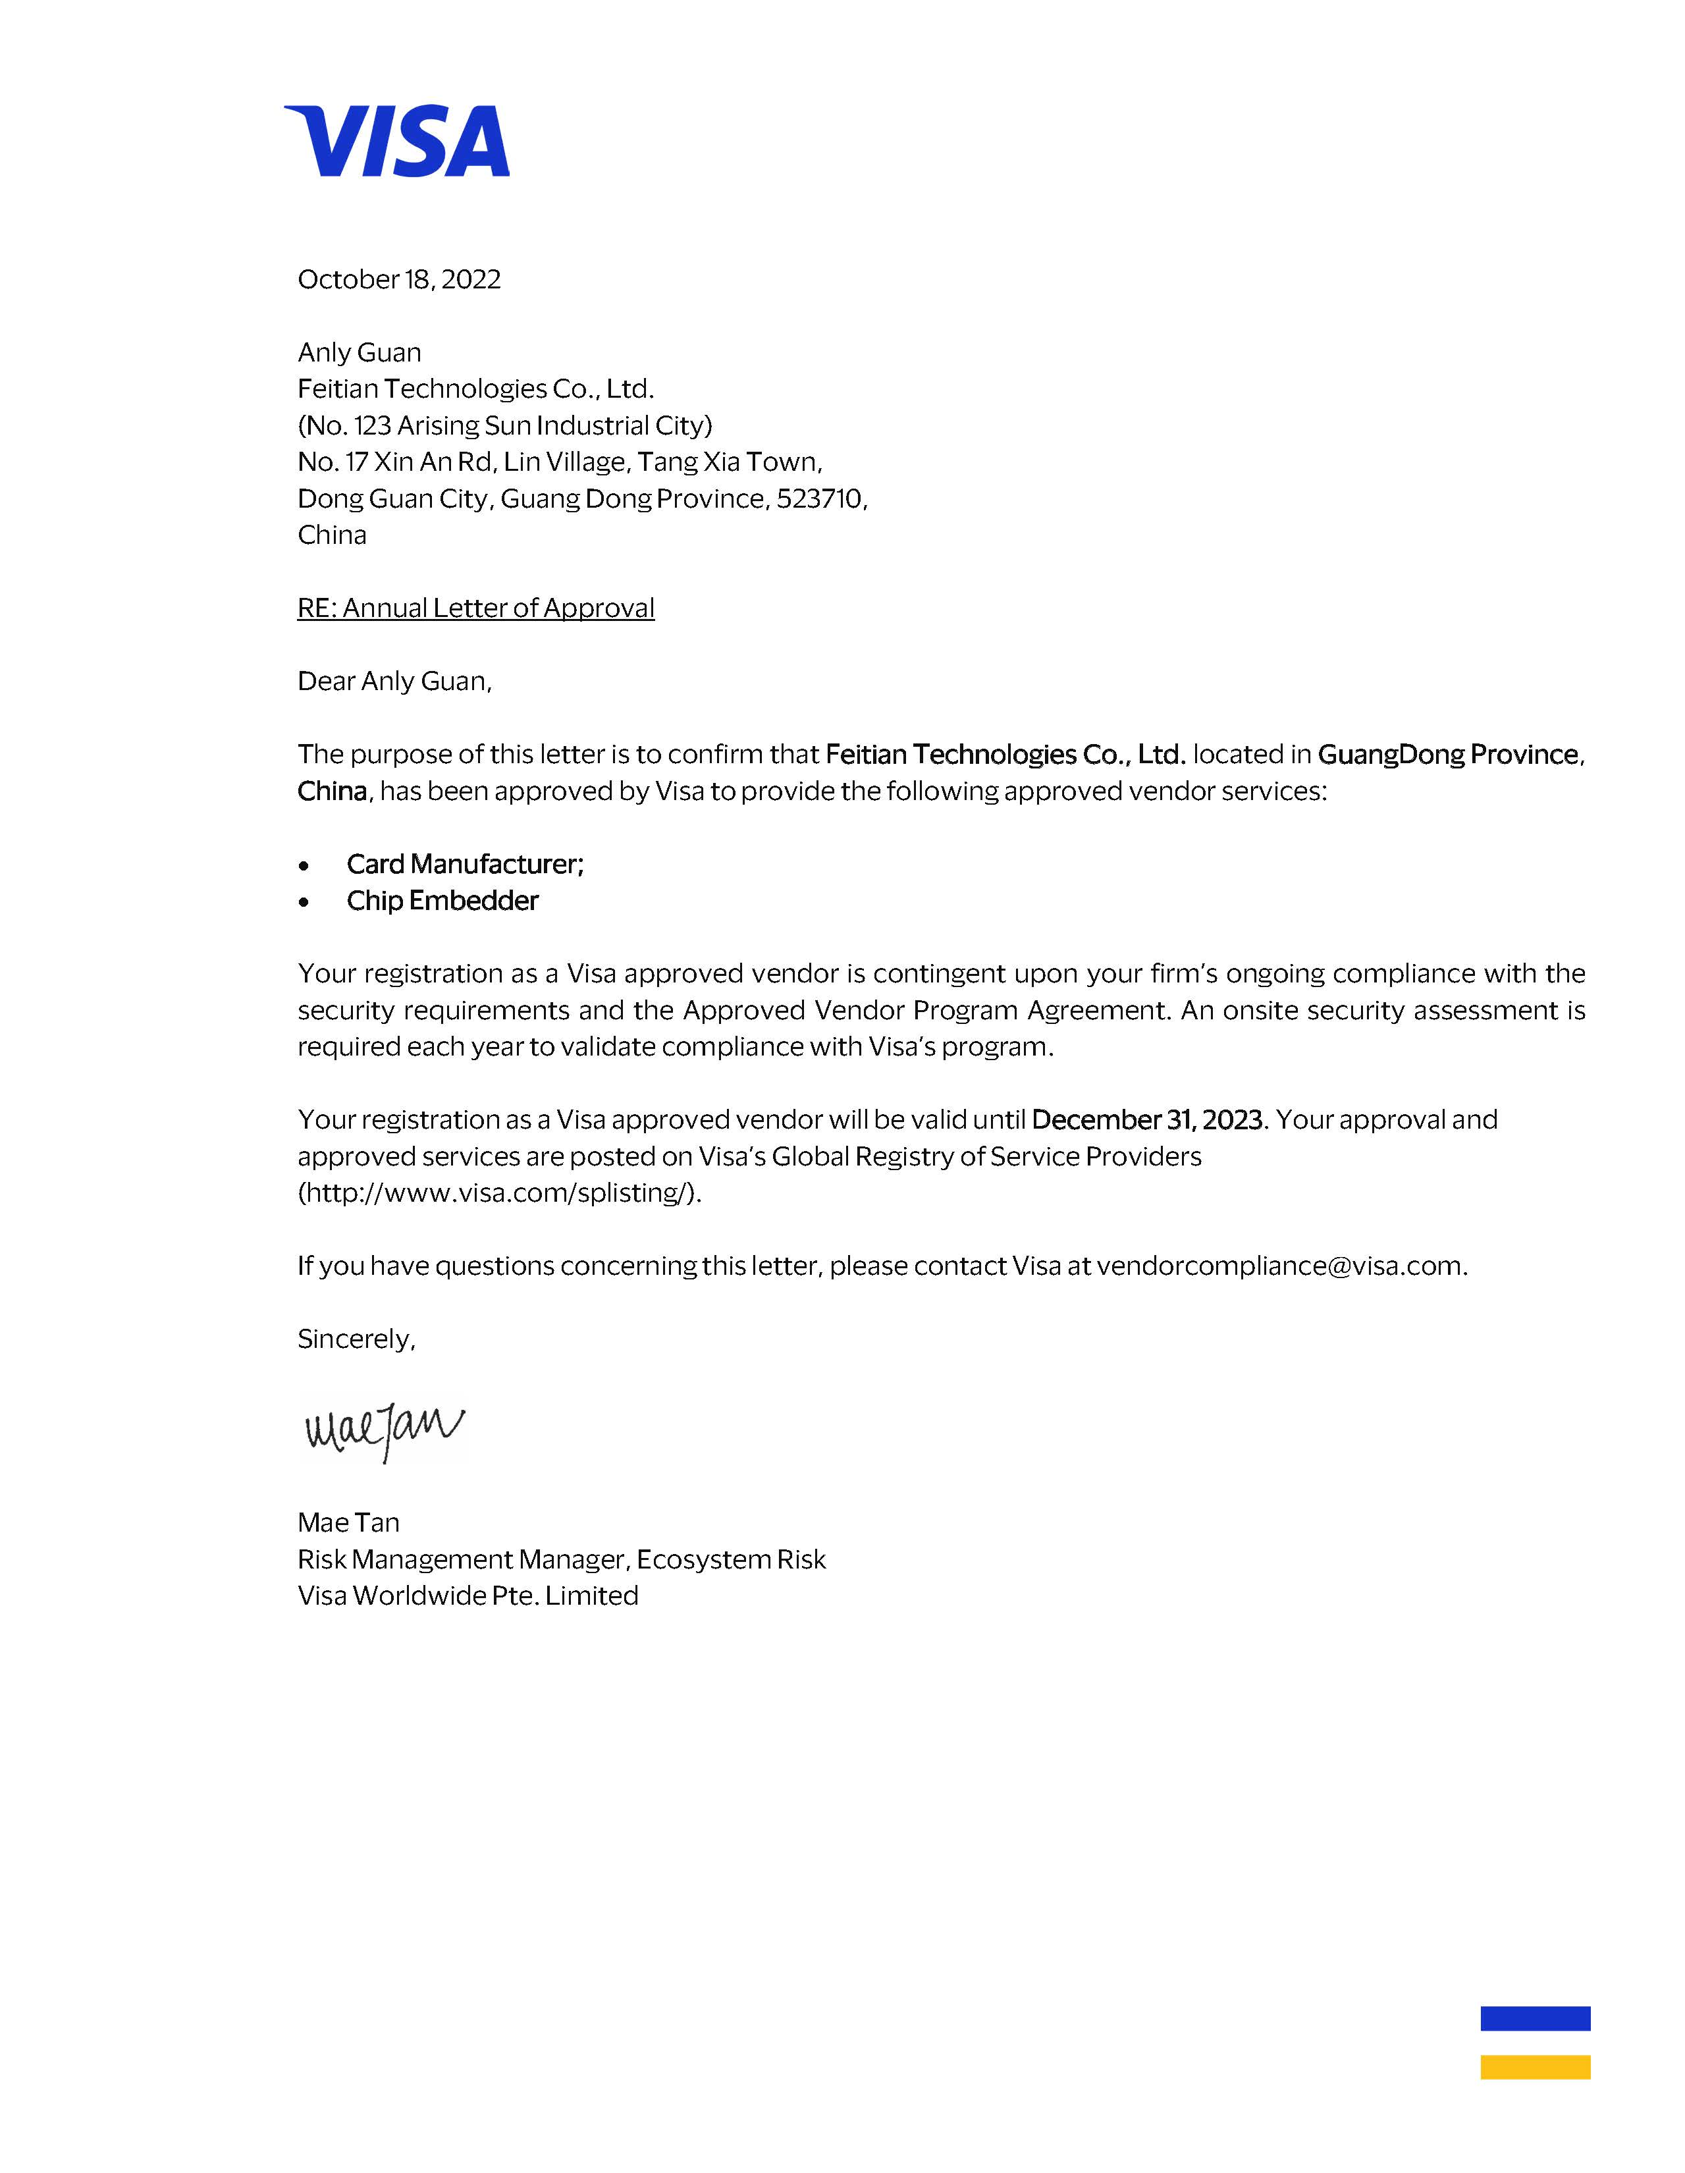
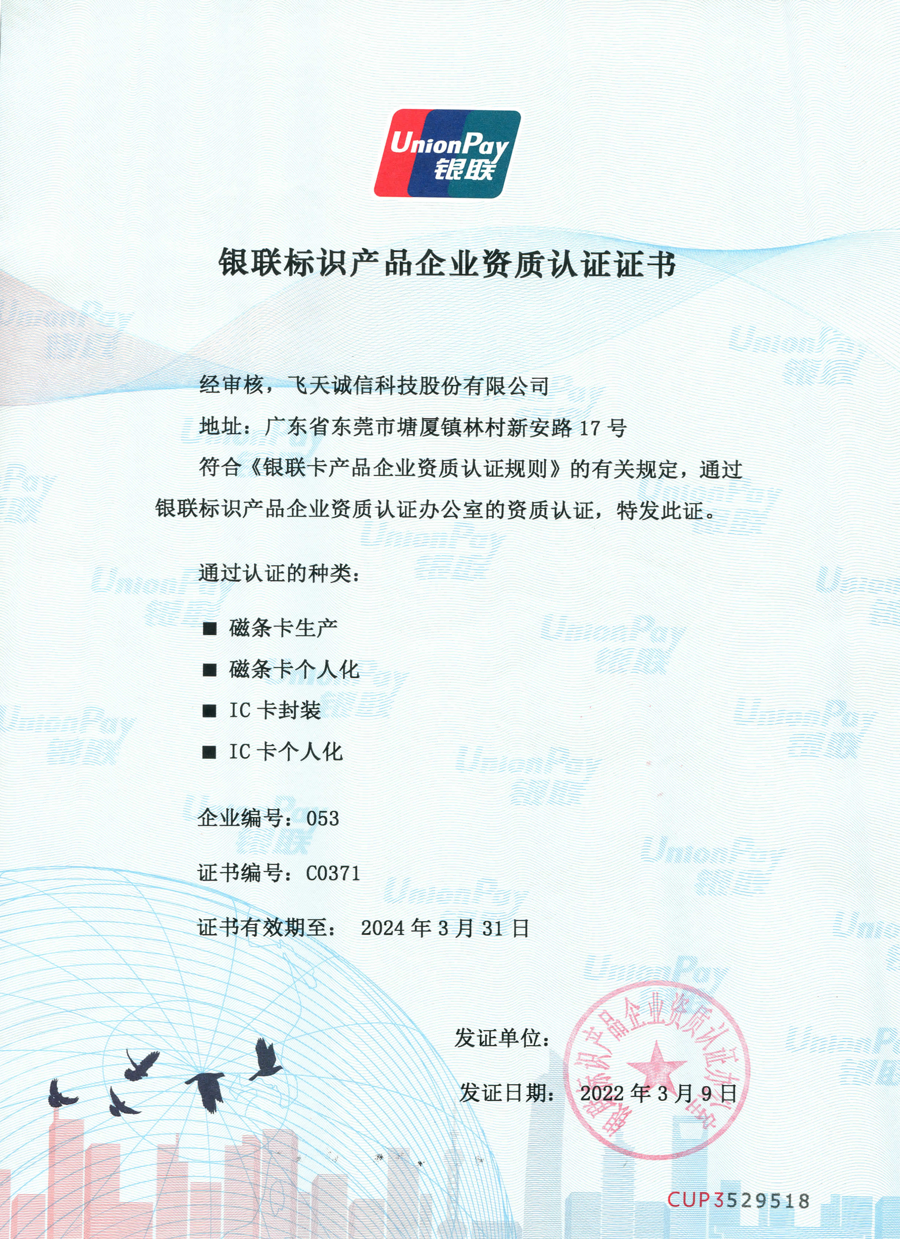
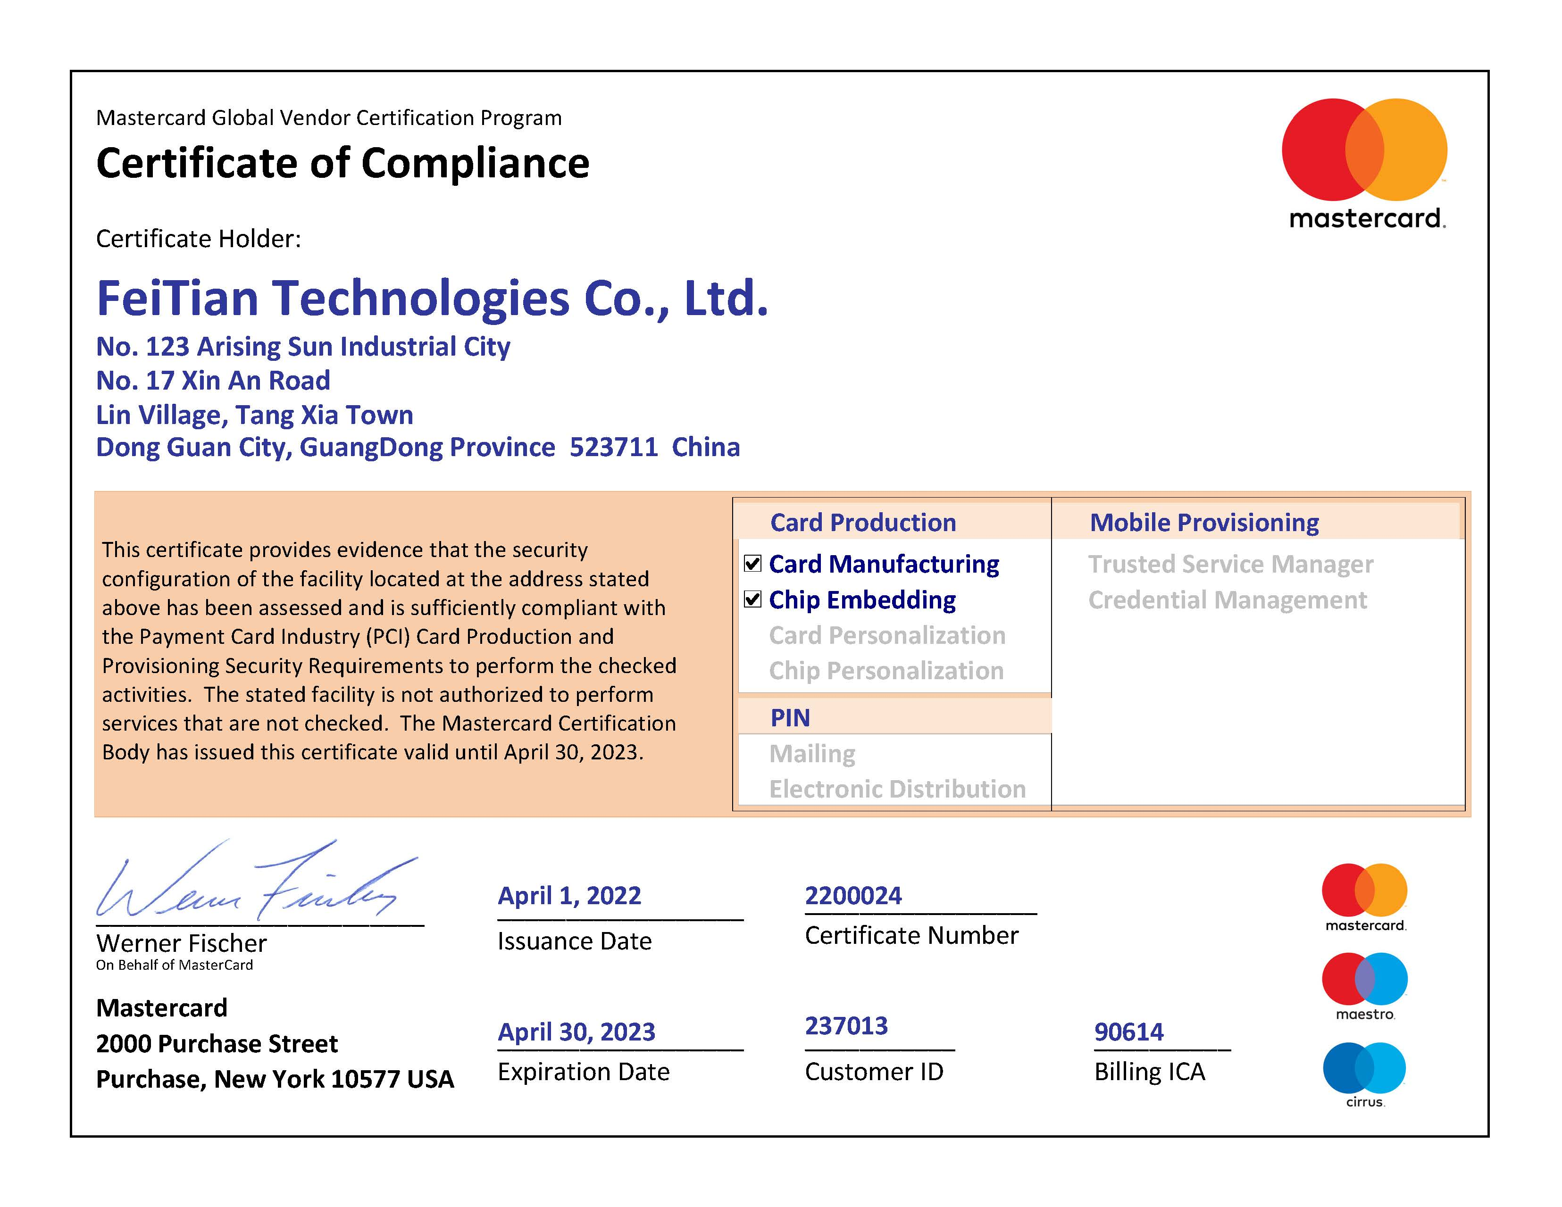
SMARTCARD PRODUCTS
FEITIAN Own Java OS for Smart Card: FT-JCOS
Global Payment Scheme
Mastercard
VISA
UnionPay

Slide 13
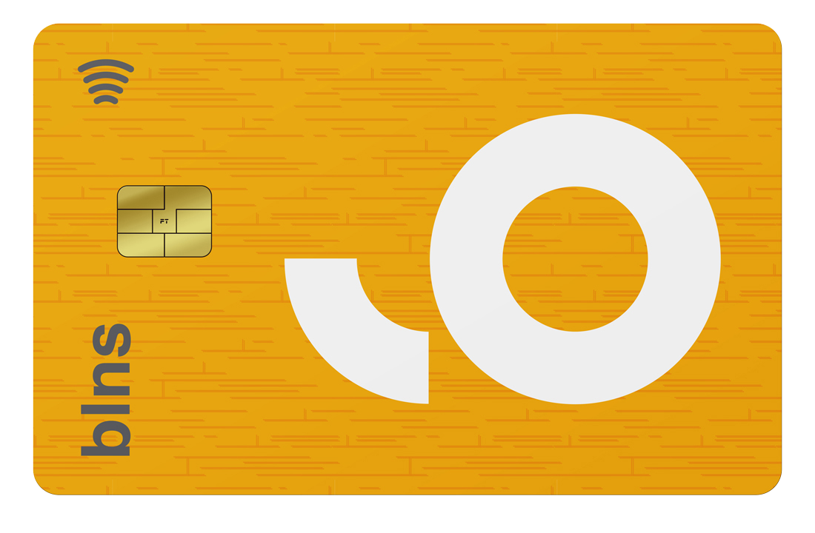
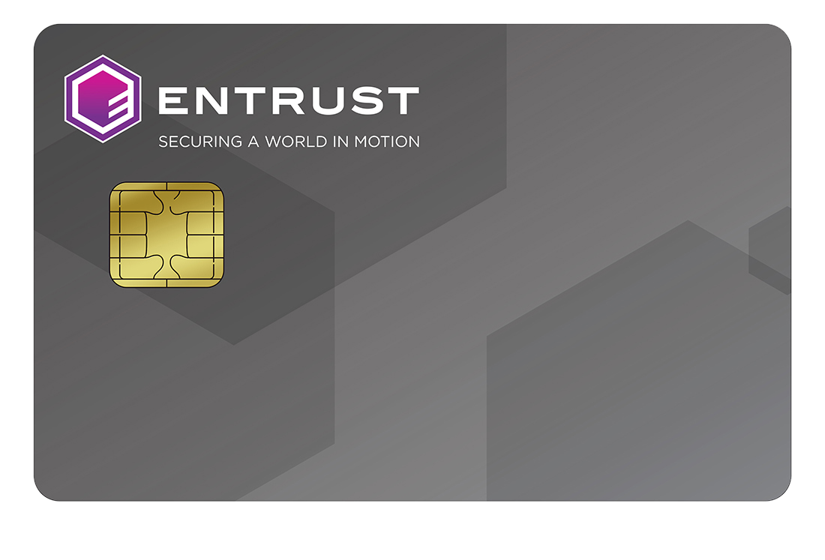
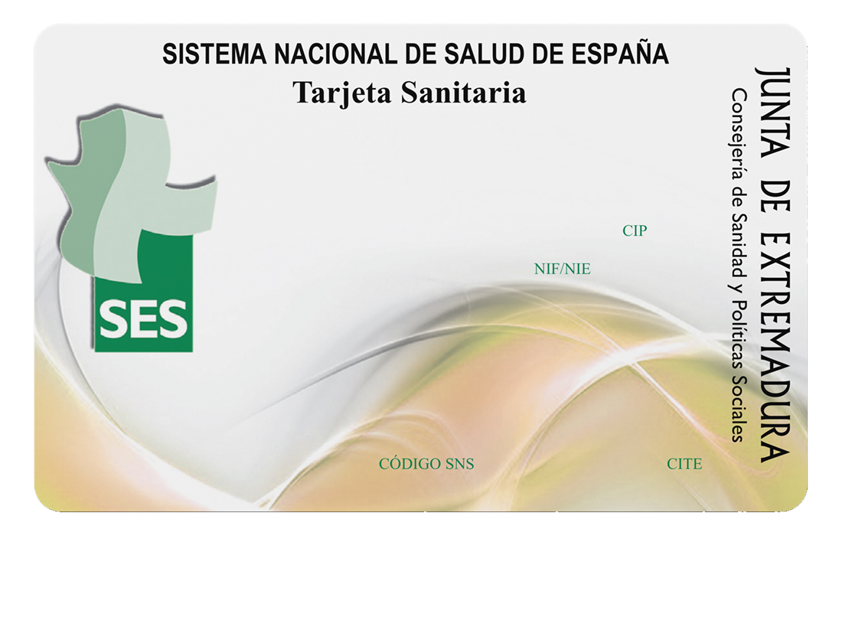
SMARTCARD PRODUCTS
Classic Card
Dual Interface Card
Contact Card
Contactless Card

Slide 14
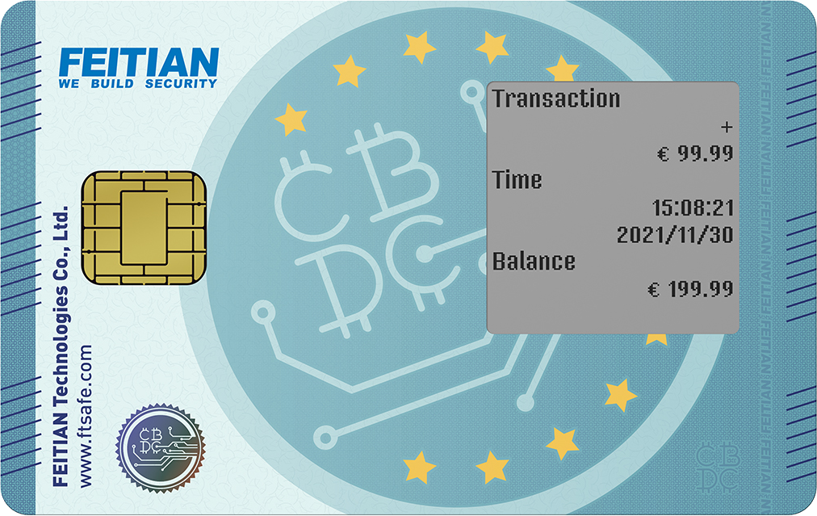
SMARTCARD PRODUCTS
Power Card
OTP Card & Mini OTP Card
CBDC Card
Fingerprint Card

Slide 15
SMARTCARD PRODUCTS
Module
Contact Module
Contactless Module
Dual Interface Module

Slide 16
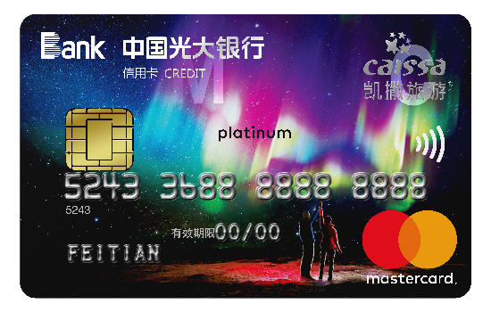
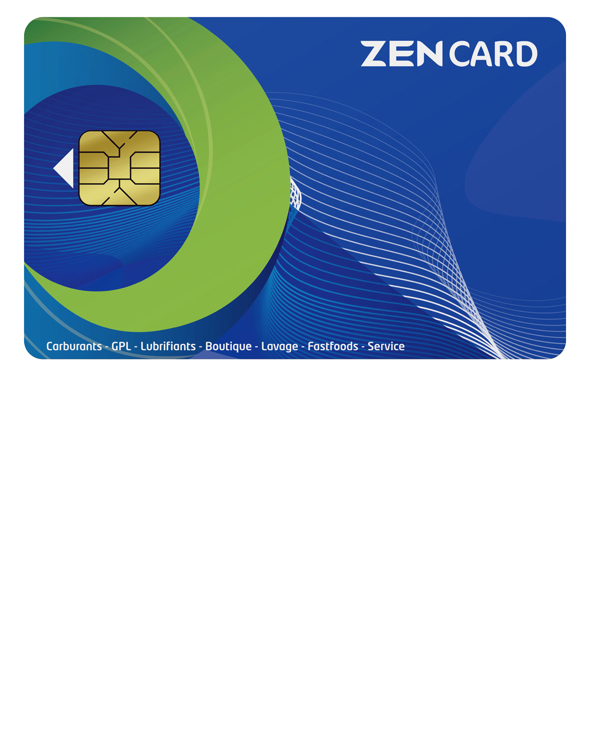
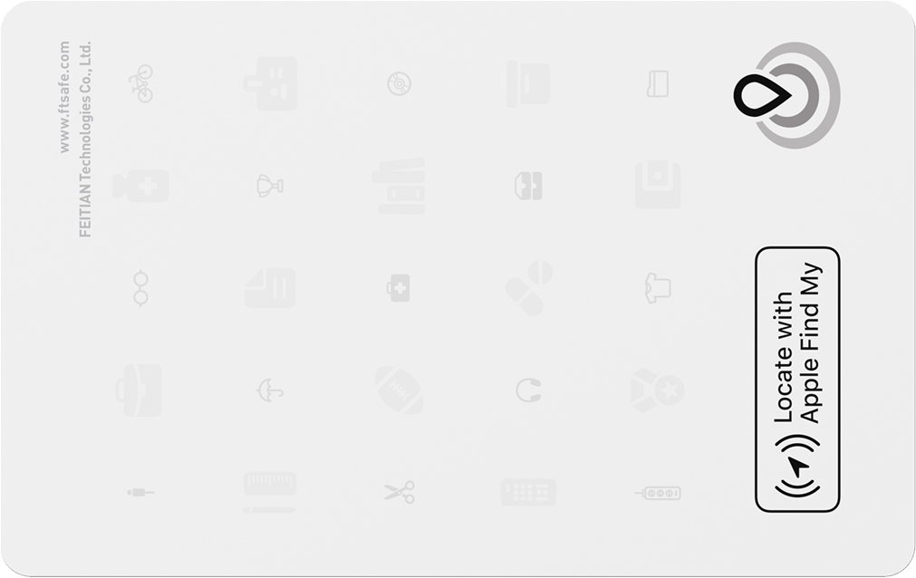
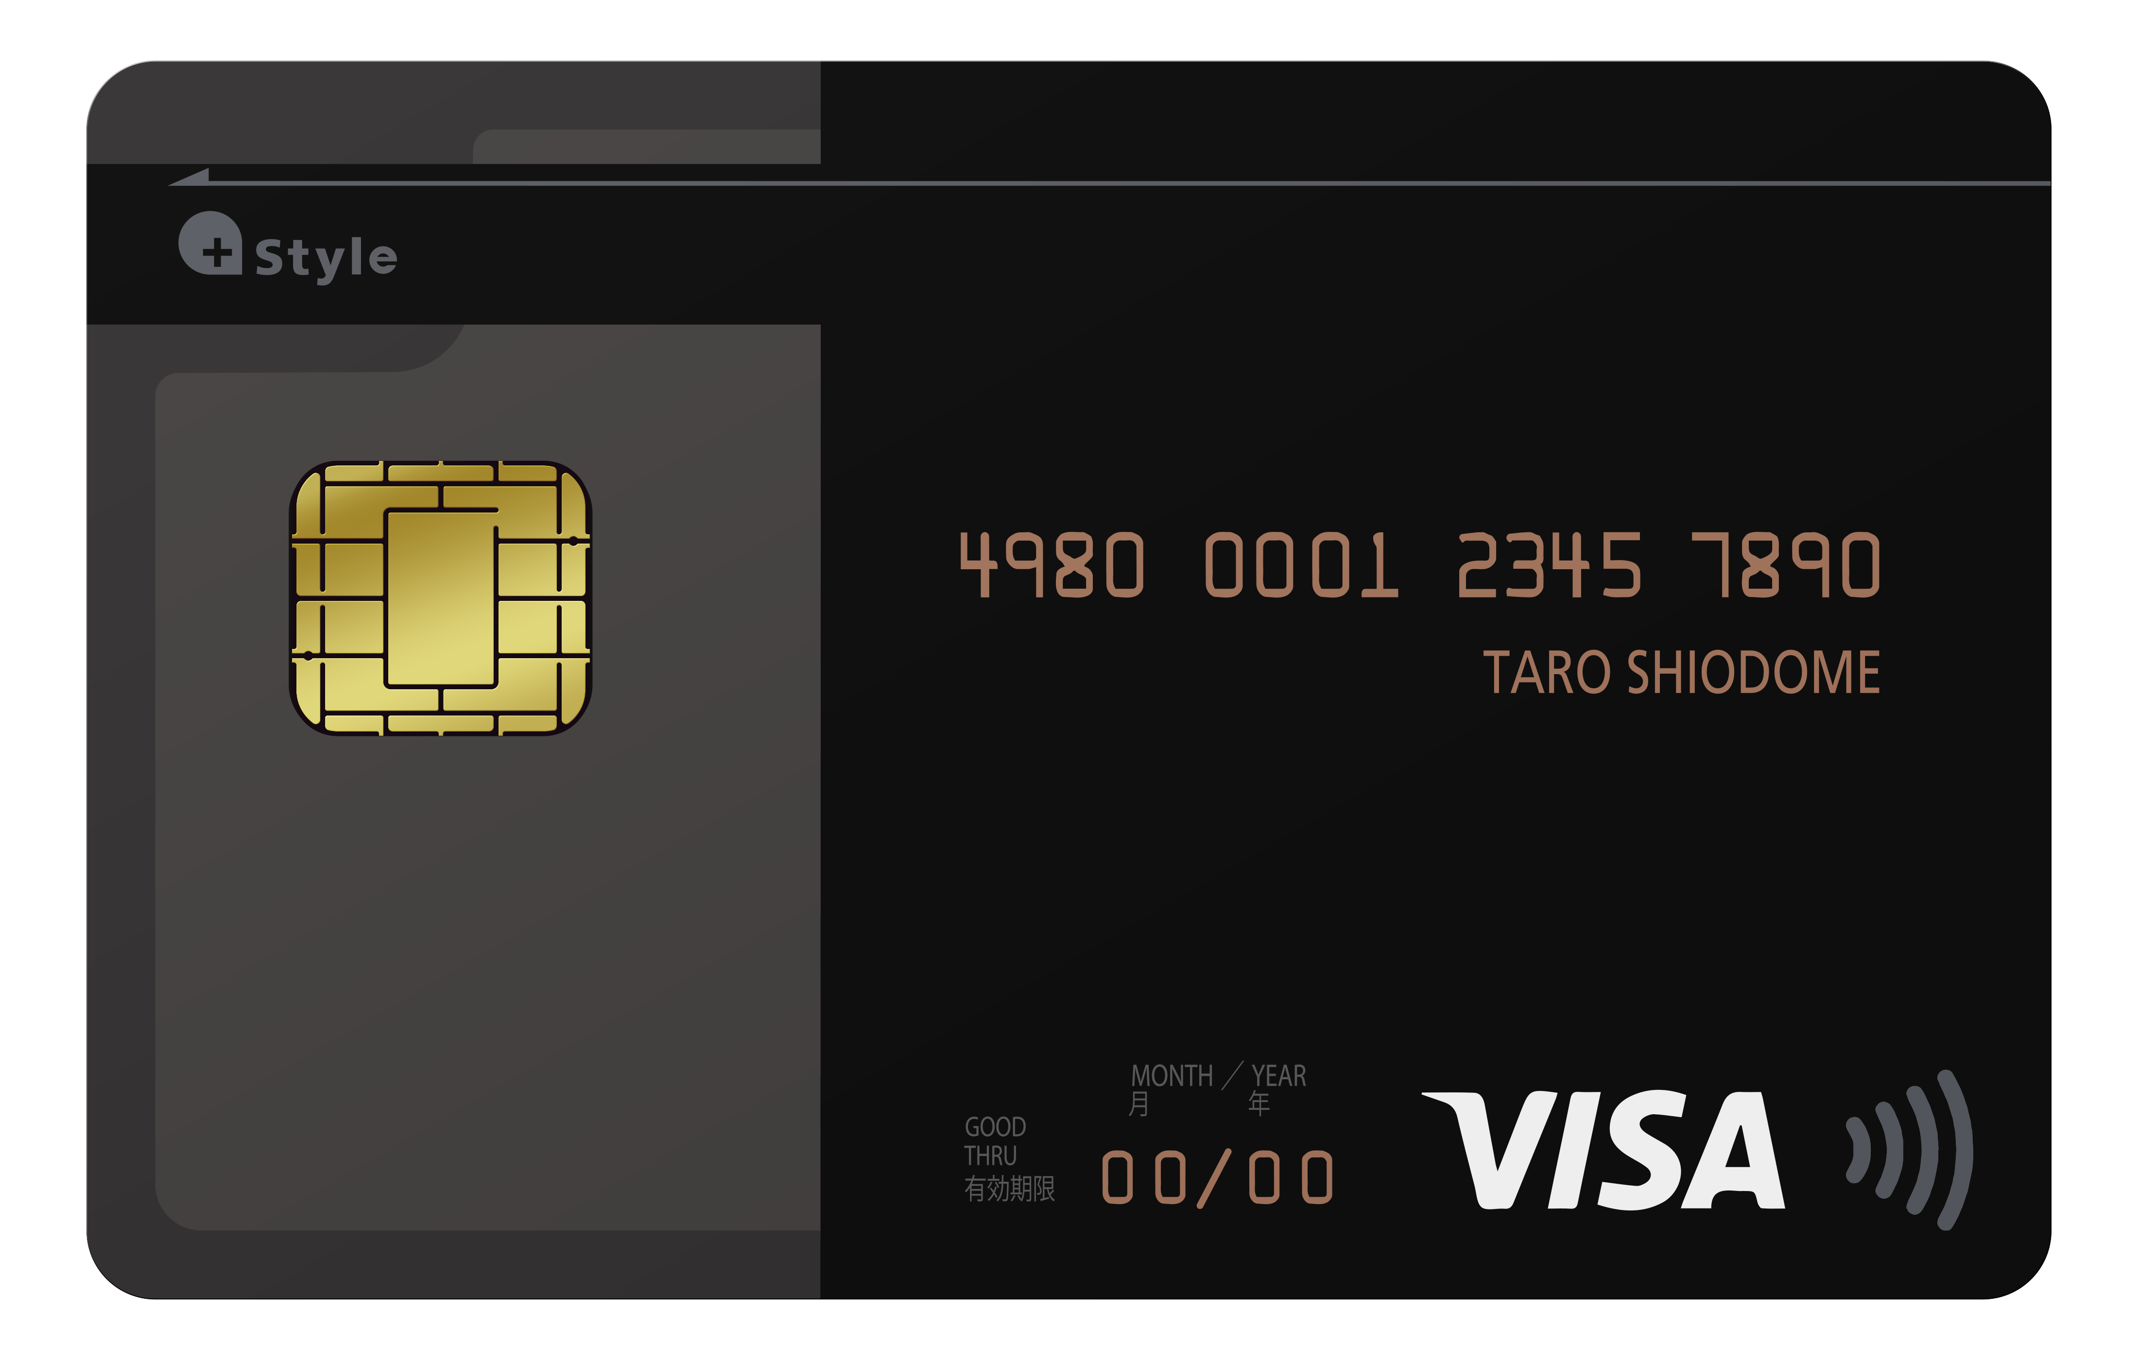
SMARTCARD PRODUCTS
Application
Payment
Government
Enterprise

Slide 17
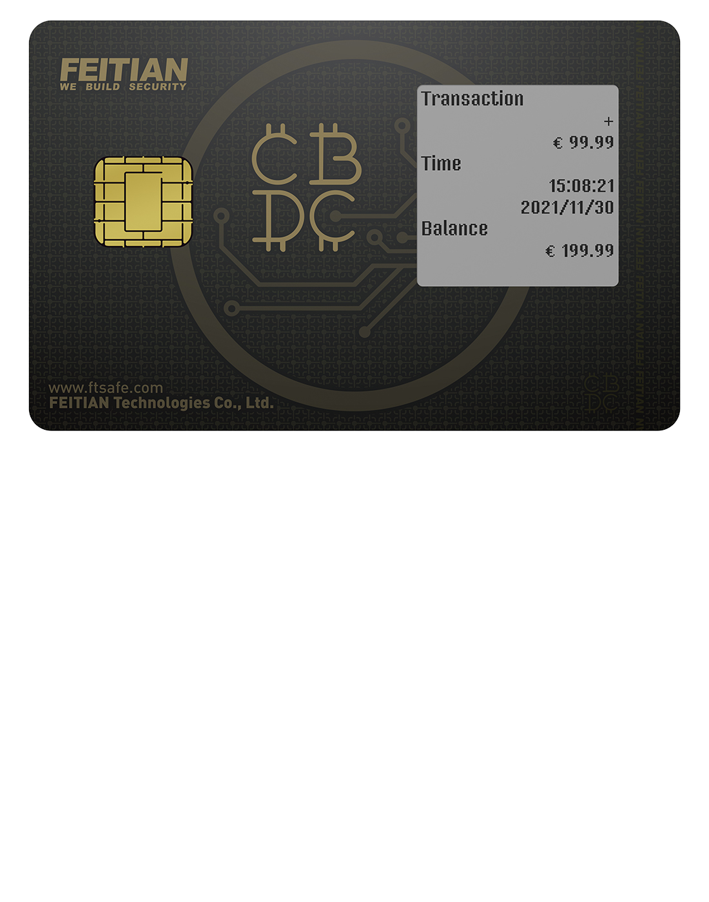
SMARTCARD PRODUCTS
Card Body
Classic Card
Ceramic Card
Color Core Card
Transparen Card
Metal Sticker Card
Power Card
OTP Card
Fingerprint Card
Bluetooth Card
CBDC Card

Slide 18
Fingerprint Card

Slide 19
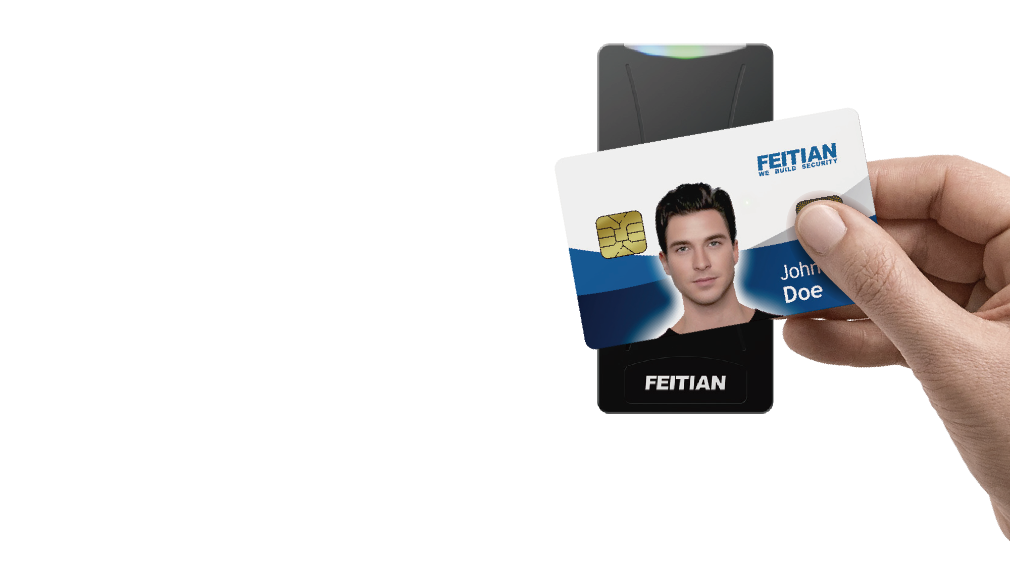
Power Card
Fingerprint Card
FEITIAN Fingerprint Card is a Smart Card embedded with biometric sensor and a secure element.
Biometric Image Capture
(Enrollment / Veriﬁcation)
Image Feature Extraction
Secure Template Storage
Matching on SE
SECURE
PAYMENT
These functions are performed within the card. The fingerprint data never leaves the card.
FEITIAN Fingerprint Card is the perfect combination of portability and security for payment and access control.
ACCESS
CONTROL

Slide 20
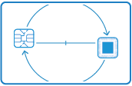
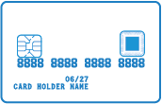
Power Card
Fingerprint Card
COMPATIBILITY
PRIVACY
Compatible with current payment
terminals.
All security data of fingerprint are
performed within the Secure
Element
EASY ENROLLMENT
FLEXIBLE SENSOR POSITIONING
Multiple enrollment modes.
Embossing supported
Easy production

Slide 21
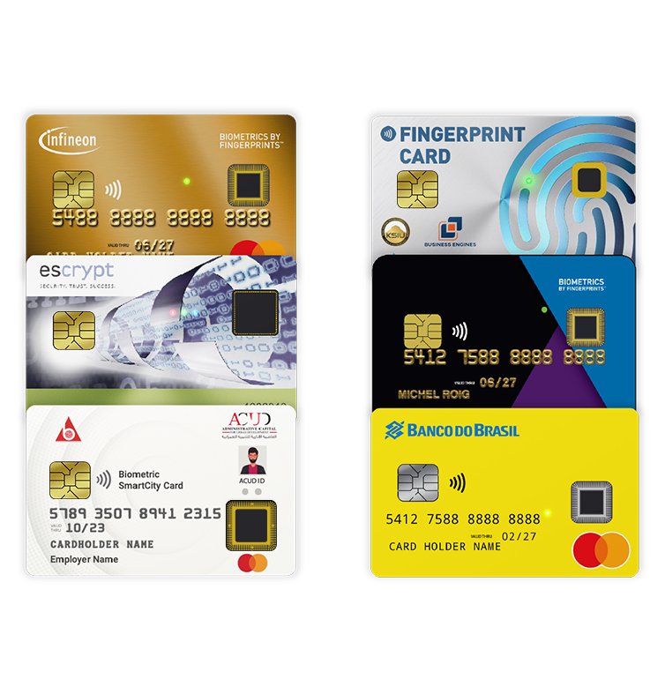
Fingerprint Card
User Case
payment
management
IDENTIFICATION
management
Access Control
management

Slide 22
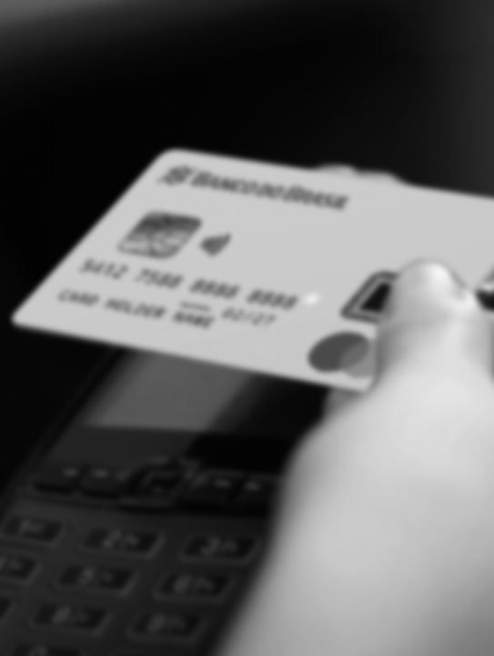
Fingerprint Card
User Case
payment
Making a payment transaction with FEITIAN fingerprint card is easier than ever before:
●
●
●
●
Securer: use fingerprint to replace PIN.
More convenient: user is able to finish transaction by just a finger touch instead of entering PIN code.
With fingerprints to conveniently and safely verify the cardholder’s identity for in-store purchase.
Global payment authorities include VISA and MasterCard are now able to certify the fingerprint card. FEITIAN will get the fingerprint card MasterCard certificate Q2 2023.

Slide 23
Fingerprint Card
User Case
IDENTIFICATION
FEITIAN fingerprint card for identification and authentication:
●
●
●
●
FIDO, PIV, PKI applets are preloaded. FEITIAN fingerprint card is FIDO2 certified.
Multi-factor authentication: Secure and convenient passwordless MFA login with FEITAIN fingerprint card, using a fingerprint, with PIN as a fallback.
Strong second factor authentication: Fingerprint verification provides an extra layer protection.
Strong biometric security: whenever a finger is detected, a template is extracted and stored inside the card, never leave the card.

Slide 24
Fingerprint Card
User Case
Access Control
FEITIAN fingerprint card used as physical access control badge:
●
●
FEITIAN fingerprint card used as a badge during Beijing Olympic Winter Games.
High security: even the badge is lost, it cannot be used to get access unless the fingerprint is verified.
Secure Web Access
Very Secure web login as the cards generates new Key pairs for every web application.
Secure Physical Access
Biometric contactless access authentication that is ideal for physical access control. As ID credentials are no longer exposed to theft.
Match-On-Card
The card holder’s fingerprint templates are stored within the card and the live template is sent to the card for matching and to gain access to protected files.
Unified Gate
Reduced complexity as end users can manage all access protocols (Physical and logical) through one card.
Fast Integration
Faster integration within applications using the WebAuthN protocol for strong authentication based on the FIDO2 protocol’s public key cryptography.
Multiple Applications
Multiple applications could be personalized on the card based on client requirements.

Slide 25
PRODUCTION
FACILITY

Slide 26
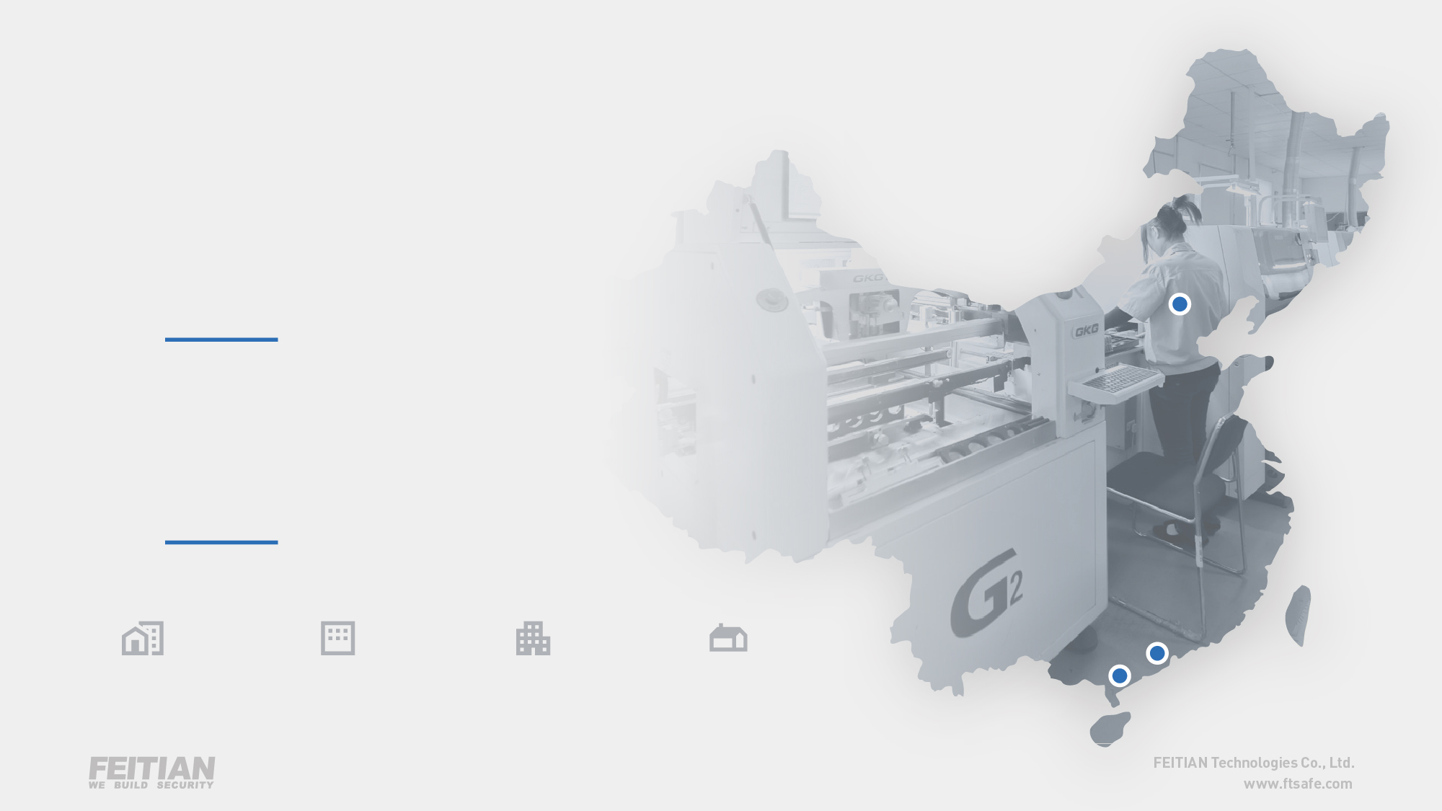
PRODUCTION FACILITY
OVERVIEW
2
Production Management
Centers
1
Card
Factory
9,398 m²
TOTAL AREA
6,166 m²
PLANT AREA
1,589 m²
OFFICE AREA
1,603 m²
DORMITORY AREA

Slide 27
PRODUCTION FACILITY
QUALIFICATIONS
Anti-Counterfeit Cards Production License
IC Cards Production License
Printing License
Anti-Counterfeit Membership of GD Province
Anti-Counterfeit Membership of Beijing
MasterCard
VISA
CUP
JCB
AMEX
ISO 9001
ISO 14001
ISO 27001
OHSAS 18001

Slide 28
THANK
YOU
Established in 1998, FEITIAN Technologies is a global leading provider of cyber security products and solutions with customers located in over 100 countries and regions.
A dedicated international team from 3 offices in Europe, North America and Asia allows us to serve our clients around the world.
The large number of R&D engineers who occupy more than half of FEITIAN's 1000+ employees, the continuous high investment in R&D, and the deep understanding of customers' needs over the past 20 years have enabled FEITIAN to continuously develop diversified and innovative products with international patent rights and certifications.
FEITIAN has highly specialized and automated production facilities, which gives us strong production capacity and high quality end products.
As a listed company, FEITIAN has always been committed to providing customers with reliable and
cost-effective products.
www.ftsafe.com

