Slide 1
FEITIAN ePass Series Products Introduction
Feitian Technologies Co., Ltd
www.ftsafe.com

Slide 2
Agenda
The Overview of FEITIAN ePass Product
Technical Features of ePass
Sending Encrypted Email Using ePass
Protect Web Logon Using ePass
Protect VPN Logon Using ePass

Slide 3
FEITIAN ePass Models
High-performance 32-bit smart card chip
ePass3003/3003Auto
BioPass
InterPass
3000
Token
Maximized cost-effective model
ePass2001
ePass2003
StorePass→GreenPass
2000
Money saver model
ePass1000Auto
1000
Notes:
3

Slide 4
The Overview of FEITIAN ePass Product
Technical Features of ePass
Sending Encrypted Email Using ePass
Protect Web Logon Using ePass
Protect VPN Logon Using ePass

Slide 5
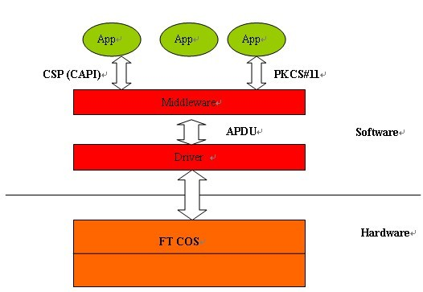
Structure of Feitian PKI products?

Slide 6
ePass1000Auto
Features
Plug & Play under Windows2000 or higher, Automatically Install Middleware and Manager Tool.
Built-in 8-bit Smart Card Chip.
Support Generation of 512-bit, 1024-bit and 2048-bit RSA Key Pair Onboard.
Support DES, 3DES and SHA-1 Algorithms Onboard.
Onboard Digital Signature Generation and Verification.
Hardware Implemented Random Number Generator.
Secure file system inside, 64K Secure Memory on Chip.
Full support for PKI applications, CSP and PKCS#11 Interfaces Available
Support Storing Multiple Keys and Certificates
Model | Memory | Features
ePass1000Auto (non-driver) | 32KB | Plug & Play No support smart card logon

Slide 7
ePass2000 Series
Features
8-bit/16-bit smart card chip
Algorithms
onboard: DES, 3DES ,AES,SHA-1,HMAC-SHA-1, RSA1024/2048, ECDSA,RNG
Onboard Asymmetric calculation, private key can never be retrieved
Supports MS CAPI & PKCS#11 API
Secure storage of x.509 v3 digital certificates
Supported OS
32&64-bit windows, Linux and Mac

Slide 8
ePass2000 Series
Model | Memory | Features
ePass2003 | 64KB | Support Microsoft Mini driver, FIPS Certified(in process) Supports windows smart card logon
ePass2001 | 32KB | HID driverless device Onboard RSA2048,ECDSA,AES,HMAC-SHA-1
StorePass/GreenPass | 8GB default flash memory | Hybrid device which combines Flash memory with Public Token Infrastructure technology. / Zero foodprint.

Slide 9
ePass3000 Series---High-Performance 32-bit smart card PKI Token
Features
32-bit smart card chip
Higher speed: Generate RSA1024 bits key pair < 2 seconds
Algorithms
onboard: DES, 3DES , RSA1024/2048, ECDSA,RNG
Onboard Asymmetric calculation, private key can never be retrieved
Supports MS CAPI & PKCS#11 API
Secure storage of x.509 v3 digital certificates
3003Auto is an plug&play model.
Supported OS
32&64-bit windows, Linux and Mac

Slide 10
ePass3000 Series---High-Performance 32-bit smart card PKI Token
Model | Memory | Features
ePass3003Auto | 64KB | HID driverless device Onboard RSA2048,ECDSA,AES,HMAC-SHA-1
InterPass3000 | 64KB | Display: Displaying transaction details Buttons: to confirm or cancel the transaction.
BioPass3000 | 64KB | PC/SC driver, supports smart card logon Anti-Fraud fingerprint sensor: working as PIN

Slide 11
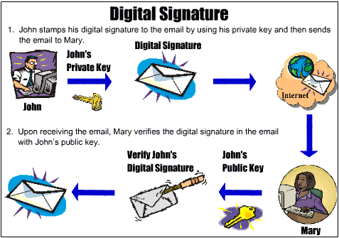
ePass Case Study

Slide 12
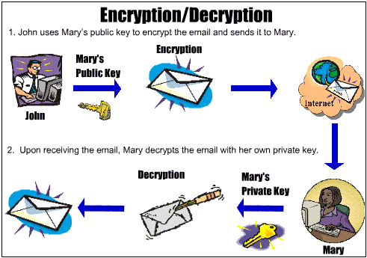
ePass Case Study

Slide 13
The Overview of FEITIAN ePass Product
Technical Features of ePass
Sending Encrypted Email Using ePass
Protect Web Logon Using ePass
Protect VPN Logon Using ePass

Slide 14
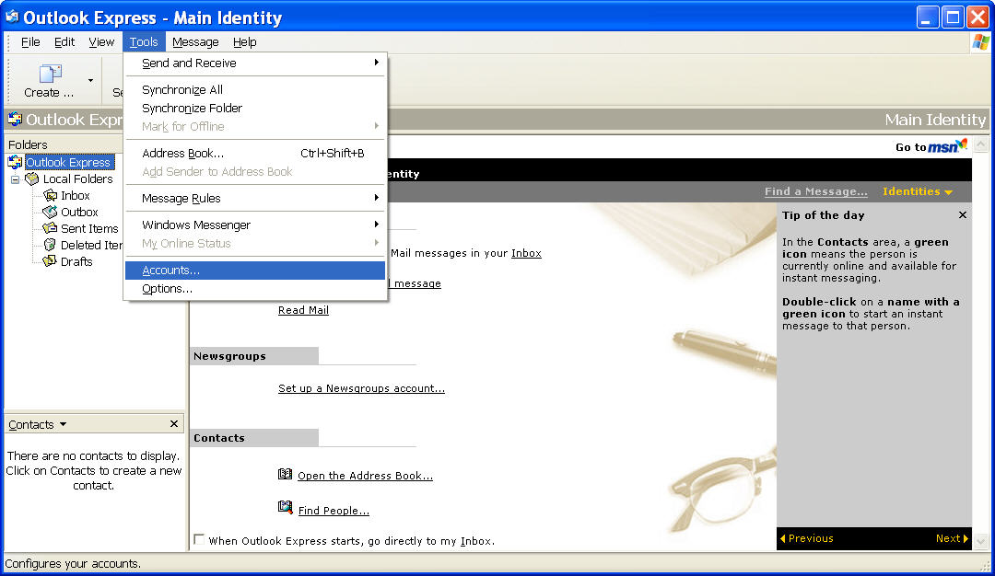
Configuring Email Account Security
To configure email account security in Outlook Express:
Log into Windows.
Make sure that you have obtained a digital ID used for email security. You can obtain a digital ID through an external website of a certificate service provider, or using Windows Server 2003 certificate server.
Start Outlook Express.
Next, Select Tools → Accounts in Outlook Express.

Slide 15
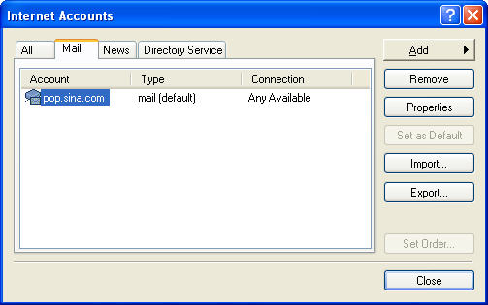
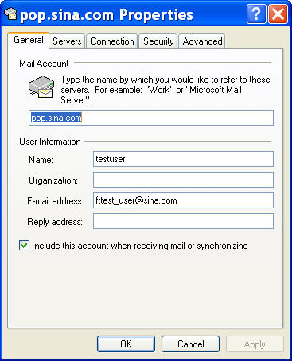
Configuring Email Account Security
5. After opening Internet Accounts window, click Mail tab. Choose an email account from the list (here, an account has been configured in advance). Click Properties.
6. A property settings window appears. Click General tab to check for any errors for this account.

Slide 16
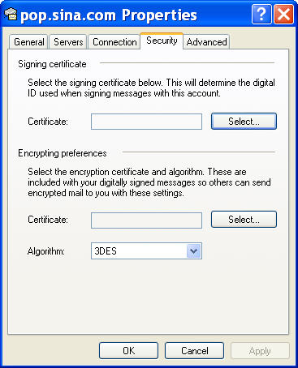
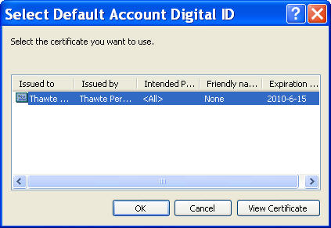
Configuring Email Account Security
7. Click Security tab. The following interface appears:
8. To enable digital signature capability of this account, click Select… button in Signing certificate area to select a digital ID. To enable encryption capability of this account, click Select… button in Encrypting preferences area to select a digital ID. In addition, you can select an algorithm you want to use from the drop-down list below.
9. By clicking Select… button, the following interface appears:

Slide 17
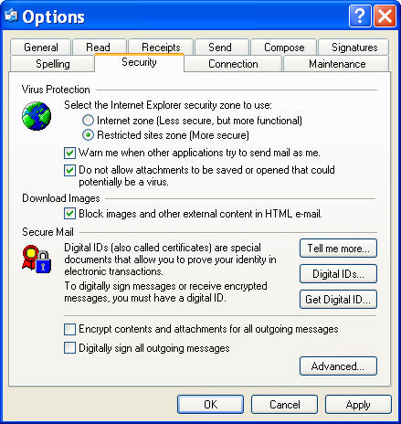
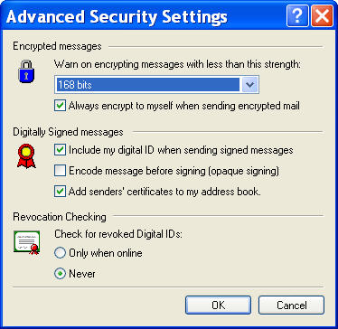
Configuring Email Account Security
10. Select a certificate and click OK. You will be returned to the main interface of Outlook Express.
11. Select Tools → Options. Click Security tab in the dialog box that is displayed.
12. If you want to send each email with a digital signature, check Digitally sign all outgoing messages option. Or, you can digitally sign an email you want to send as described below.
13. If you want to encrypt the information of each outgoing message, check Encrypt contents and attachments of all outgoing messages option. Or, you can encrypt an individual message as described below.
14. Click Advanced… below. The Advanced Security Settings dialog box appears.

Slide 18
Configuring Email Account Security
15. Check Include my digital ID when sending signed messages option and Add senders’ certificates to my address book option in Digitally Signed messages area if you have not. This guarantees that the sender can gain its opponent’s key information used for encrypting its outgoing messages properly, because the sender needs to use the opponent’s key (which is stored in a digital ID) to encrypt and send messages to the opponent.
Additionally, you can specify key length or other settings. Now, the configuration of message encryption and signing is complete.

Slide 19
Sending Emails with Digital Signature
To append a digital signature to a message:
Log into Windows.
Start Outlook Express.
Click Create Mail on the upper left to open a mail text input window.
Complete the mail.
Click Signature and Send. A PIN input box appears. Type the PIN of your ePass2001 device in the box. The mail will be sent out. If it is still in the Outbox, click Send/Recv to send the mail to the mail server. (The opponent will be shown a digital signature prompt. To read the mail, click Continue. To verify if the signature is valid or not, go to Security tab in the Mail Properties window by clicking the Signature icon on the left.)

Slide 20
Obtaining Recipient’s Public Key and Certificate
To send an encrypted email, you must have the public key or certificate of your opponent, which can be used to encrypt the message you are sending. In this case, only the private key (typically held by the recipient) matching the public key can be used to decrypt the message.
To obtain the public key or certificate, ask the recipient to send you a message first, which is enclosed with a digital signature. Save the digital ID after receiving the message. Thus, you have the opponent’s certificate and public key at hand.
To save the certificate or public key:
Ask the recipient to send you a message with a digital signature as described in the previous section.
Start Outlook Express to receive the message and open it.
Right-click on Sender column and select Add to address book. Click OK. The recipient and its public key and certificate are saved to your Outlook Express address book.

Slide 21
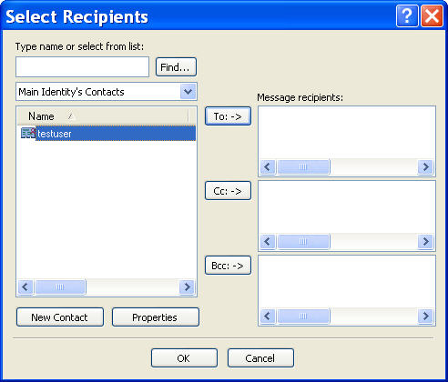
Sending Encrypted Emails
Before sending an encrypted email, you must have your recipient’s public key or certificate.
To send an encrypted message:
Click Create Mail on the upper left in Outlook Express.
Choose the recipient of the message. If the recipient has a digital ID, the icon before it is marked with a red certificate sign. You must choose a recipient with a digital ID.

Slide 22
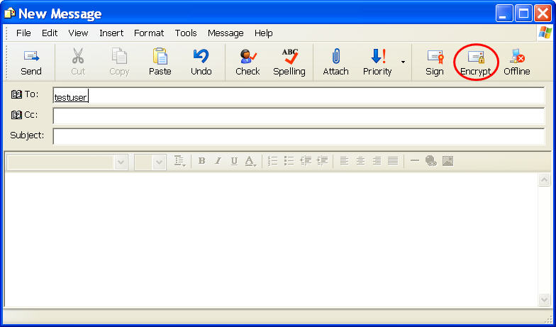
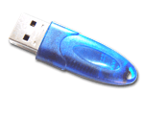
Sending Encrypted Emails
3. Fill out the email.
4. Click Encrypt button as shown below.
5. Click Send button.
When the recipient receives the mail, a PIN will be
required to read the mail. The recipient should type
the PIN of the ePass2001 device to decrypt the mail.

Slide 23
The Overview of FEITIAN ePass Product
Technical Features of ePass
Sending Encrypted Email Using ePass
Protect Web Logon Using ePass
Protect VPN Logon Using ePass

Slide 24
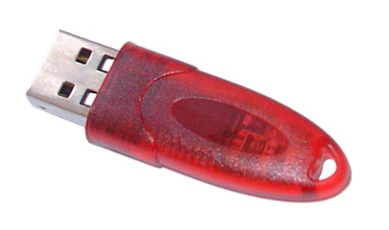
I can help you to understand Web Authentication with PKI/token ！
User visits a web page (requests a resource) via https.
Web site requires SSL Authentication before it will serve the page.
User’s browser looks for possible certificates that can be used for authentication (either in software or on token) If a hardware token is present, the user’s web browser will look for digital certificates on the token.
Here may involve prompting the user for the PIN that protects the token.
The web browser sends a message “signed” by the token along with the user’s certificate to the server.
The server verifies the signature and then trusts the identity in the certificate.
User can access the web page now.

Slide 25
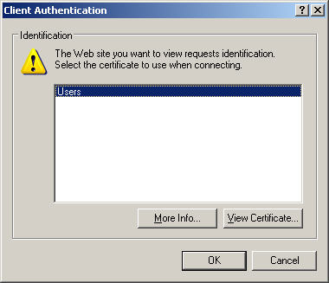
Accessing SSL-Encrypted Website
Make sure the certificate has been imported into ePass2001 device, which is connected to computer.
Connect to the target website through Internet Explorer (https://delltest:443). You might see a security prompt dialog box. If so, click Yes. The following interface appears:

Slide 26
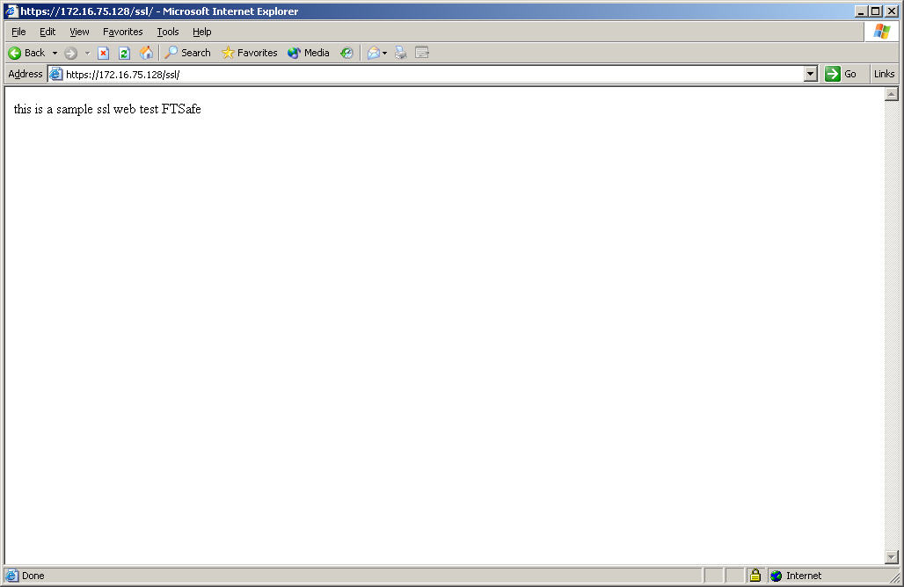
Accessing SSL-Encrypted Website
Select a certificate from the list. Click OK. Type a PIN in the PIN input box that is popped up. The secure website is open for your access now. (The following is an example site.)
This is a sample ssl web test FTSafe

Slide 27
The Overview of FEITIAN ePass Product
Technical Features of ePass
Sending Encrypted Email Using ePass
Protect Web Logon Using ePass
Protect VPN Logon Using ePass

Slide 28
Protect VPN Logon Using ePass
I can help you to understand VPN Authentication with PKI/token ！
VPN endpoints (secure gateways or clients) authenticate each other to establish a secure connection. This means that the type of authentication you use determines the level of security of your VPN. Outside of a public key infrastructure (PKI), VPNs are more susceptible to security breaches.
To establish a secure, VPN connection, use an Entrust digital certificate. There are other ways to authenticate to a VPN router, such as by using a token or user name and password; however, these do not provide the ability to encrypt and sign documents like your Entrust certificate does.
To ensure users can securely gain network access through a virtual private network (VPN), the VPN must incorporate an authentication mechanism that secures the end points of the VPN. A user name and password alone is not secure and increases the risk that an attacker can gain access to the network. As such, a second factor authentication mechanism is necessary.

Slide 29
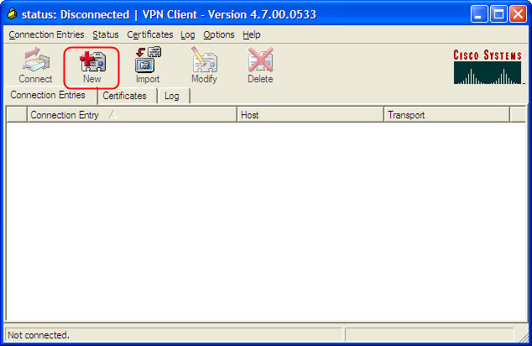
Protect VPN Logon Using ePass
To use your digital certificate for VPN authentication, you need to import your certificate into your VPN client.
Open your VPN software(VPNClientSoft). The following interface appears:
Click ‘New’ to create a VPN connection.

Slide 30
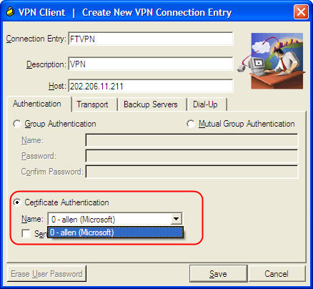
Protect VPN Logon Using ePass
Enter related information and IP address, select certificate and click ‘Save’.
Here, the certificate is the one in ePass
I have a certificate !

Slide 31
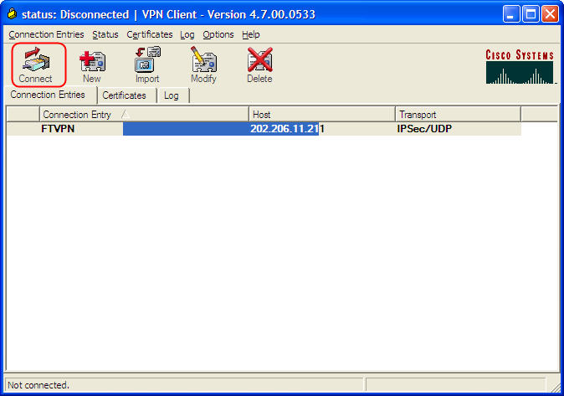
Protect VPN Logon Using ePass
After second step, the following interface appears:
Click ‘Connect’ to create connection
Connected successfully, the logo will turn to blue.

Slide 32
THE END
Thank you!

